Slide 1
Outline: Lossless-join
Chapter 15 – 3rd ed. (Chap. 15 – 4th, 5th ed.; Chap. 16, 6th ed.)
  Basic definition of Lossless-join
  Examples
  Testing algorithm

Slide 2
  Basic definition of Lossless-join
  A decomposition D = {R₁, R₂,..., R_{m}} of R has the lossless
  join property with respect to the set of dependencies F on R if, for every relation r of R that satisfies F, the following holds,
  ∗(π_{R1}(r), ..., π_{Rm}(r)) = r,
  where ∗ is the natural join of all the relations in D.
  The word loss in lossless refers to loss of information, not to loss of tuples.

Slide 3
  Example: decomposion-1
Emp_PROJ
SSN
PNUM
hours
ENAME
PNAME
PLOCATION
F = {SSN → ENAME, PNUM → {PNAME, PLOCATION},
{SSN, PNUM} → hours}
R1
R2
SSN
ENAME
PNUM
PNAME
PLOCATION
R3
SSN
PNUM
hours
Lossless join

Slide 4
  Example: decomposition-2
Emp_PROJ
SSN
PNUM
hours
ENAME
PNAME
PLOCATION
F = {SSN → ENAME, PNUM → {PNAME, PLOCATION},
{SSN, PNUM} → hours}
R1
ENAME
PLOCATION
Not lossless join
R2
SSN
PNUM
hours
PNAME
PLOCATION

Slide 5
  decomposion-1
A1
SSN
A2
ENAME
A3
PNUM
A4
PNAME
A5
PLOCATION
A6
hours
R1
b11
b12
b13
b14
b15
b16
R2
b21
b22
b23
b24
b25
b26
R3
b31
b32
b33
b34
b35
b36
R1
a1
a2
b13
b14
b15
b16
R2
b21
b22
a3
a4
a5
b26
R3
a1
b32
a3
b34
b35
a6

Slide 6
SSN → ENAME
SSN
ENAME
R1
a1
a2
b13
b14
b15
b16
R2
b21
b22
a3
a4
a5
b26
R3
a1
a2
a3
b34
b35
a6
PNUM → {PNAME, PLOCATION}
PNUM
PNAME
PLOCATION
R1
a1
a2
b13
b14
b15
b16
R2
b21
b22
a3
a4
a5
b26
R3
a1
a2
a3
a4
a5
a6

Slide 7
  decomposition-2
A1
SSN
A2
ENAME
A3
PNUM
A4
PNAME
A5
PLOCATION
A6
hours
R1
b11
b12
b13
b14
b15
b16
R2
b21
b22
b23
b24
b25
b26
R1
b11
a2
b13
b14
a5
b16
R2
a1
b22
a3
a4
a5
a6
SSN → ENAME
PNUM → {PNAME, PLOCATION}
{SSN, PNUM} → hours
The matrix can not be changed!

Slide 8
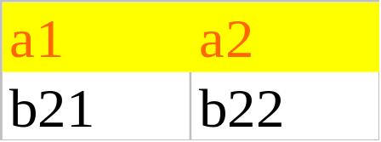
Why?
Decomposition-1:
EMP_PROJ
a1
a2
b13
b14
b15
b16
b21
b22
a3
a4
a5
a6
a1
a2
a3
a4
a5
a6
R1
R2
b13
b14
b15
a3
a4
a5
R3
a1
b13
b16
b21
a3
b26
a1
a3
a6

Slide 9
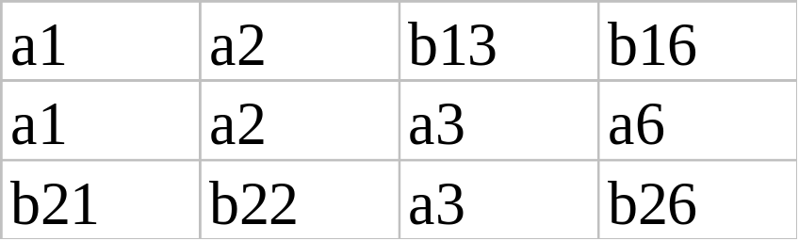
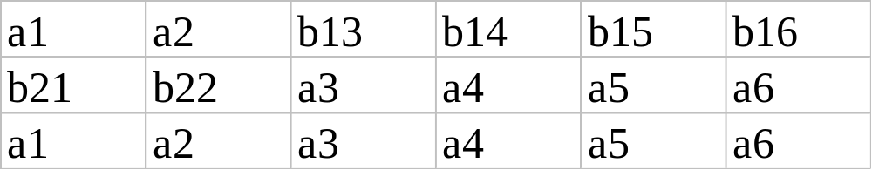
Why?
Decomposition-1:
R1 ∗ R3 = R13 =
R13 ∗ R2 =

Slide 10
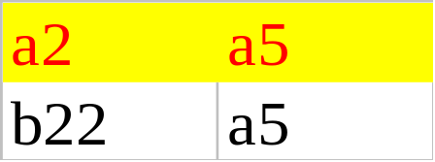
Why?
Decomposition-2:
EMP_PROJ
b11
a2
b13
b14
a5
b16
a1
b22
a3
a4
a5
a6
R1
R2
b11
b13
b14
a5
b16
a1
a3
a4
a5
a6

Slide 11
Why?
Decomposition-2:
R1 ∗ R2 =
b11
a2
b13
b14
a5
b16
a1
a2
a3
a4
a5
a6
b11
b22
b13
b14
a5
b16
a1
b22
a3
a4
a5
a6
Spurious tuples

Slide 12
Student-course-instructor:
Instructor’s teach one course only
student_no
course_no
instr_no
Student takes a course and has one instructor
{student_no, course} → instr_no
instr_no → course_no

Slide 13
student_no
course_no
instr_no
R1
Course_no
instr_no
{student_no, course} → instr_no
instr_no → course_no
R2
student_no
instr_no
A1
stu-no
A2
course-no
A3
instr-no
A1
stu-no
A2
course-no
A3
instr-no
R1
b11
b12
b13
R1
b11
a2
a3
R2
b21
b22
b23
R2
a1
b22
a3
R1
b11
a2
a3
R2
a1
a2
a3

Slide 14
student_no
course_no
instr_no
R1
Course_no
instr_no
{student_no, course} → instr_no
instr_no → course_no
R2
student_no
course_no
A1
stu-no
A2
course-no
A3
instr-no
A1
stu-no
A2
course-no
A3
instr-no
R1
b11
b12
b13
R1
b11
a2
a3
R2
b21
b22
b23
R2
a1
a2
b23
instr_no → course_no
R1
b11
a2
a3
R2
a1
a2
b23

Slide 15
student_no
course_no
instr_no
R1
student_no
instr_no
{student_no, course} → instr_no
instr_no → course_no
R2
student_no
course_no
A1
stu-no
A2
course-no
A3
instr-no
A1
stu-no
A2
course-no
A3
instr-no
R1
b11
b12
b13
R1
a1
b12
a3
R2
b21
b22
b23
R2
a1
a2
b23
R1
a1
b12
a3
R2
a1
a2
b23

Slide 16
Testing algorithm
input: A relation R, a decomposition D = {R₁, R₂,..., R_{m}} of R, and
a set F of function dependencies.
1. Create an initial matrix S with one row i for each relation Ri in
D, and one column j for each attribute Aj in R.
2. Set S(i, j) := b_{ij} for all matrix entries.
3. For each row i representing relation schema Ri Do
{for each column j representing Aj do
{if relation Ri includes attribute Aj then
set S(i, j) := a_{j};}
4. Repeat the following loop until a complete loop execution results
in no changes to S.

Slide 17
4. Repeat the following loop until a complete loop execution results
in no changes to S.
{for each function dependency X → Y in F do
for all rows in S which have the same symbols in the
columns corresponding to attributes in X do
{make the symbols in each column that correspond to
an attribute in Y be the same in all these rows as follows:
if any of the rows has an “a” symbol for the column,
set the other rows to the same “a” symbol in the column.
If no “a” symbol exists for the attribute in any of the
rows, choose one of the “b” symbols that appear in one
of the rows for the attribute and set the other rows to
that same “b” symbol in the column;}}
5. If a row is made up entirely of “a” symbols, then the decompo-
sition has the lossless join property; otherwise it does not.

Slide 18
a1
a2
b13
b14
b15
b16
b21
b22
a3
a4
a5
b26
a1
b32
a3
b34
b35
a6
R1<SSN, ENAME>
R2<PNUM, PNAME, Plocation>
a1
a2
b13
b14
b15
b21
a1
b22
b32
a3
a4
a5
a3
b34
b35
R3<SSN, PNUM, hours>
PNUM → {PNAME, PLOCATION}
a1
b13
b16
b21
a3
b26
<a3, a4, a5, a1, a3, a6>
<a3, b34, b35, a1, a3, a6>
a1
a3
a6

